Slide 1
1. Inductive Effect
Electronic effects
Electronic displacement along sigma bond due to difference in electronegativity
Permanent effect in saturated carbon chain compounds.
Group attached to carbon chain should have tendency to release or withdraw electrons.
Types of inductive effect
+ I effect effect –electron donating groups
e.g., CH₃ , C₂H_{5,} O⁻, COO⁻
– I effect effect –electron withdrawing groups
e.g., - NO₂ , –CN, COOH, X

Slide 2
Applications:
Which is more acidic?-
acetic acid or chloroacetic acid?
Bromoacetic acid or fluoroacetic acid?- dependent on electronegativity of halogen
Cl₃CCOOH or Cl₂CHCOOH- additive effect
ClCH₂CH₂COOH or ClCH₂CH₂CH₂COOH- distance effect

Slide 3
2. Mesomeric effect
Electron redistribution in unsaturated (conjugated) system involving shifting of pi electrons
Permanent effect
More prominent than inductive effect as pi electrons are more polarisable

Slide 4
3. Resonance or Mesomerism
All the properties of certain compounds cannot be explained by single structure.
Canonical structures or resonance contributing structures–differ in position of electrons.

Slide 5
Resonance hybrid is more stable than canonical structures.
Resonance structures are imaginary.
Resonance energy = Actual energy of hybrid–energy of
most stable contributing structure.
Resonance is measure of stability.
More the number of equivalent resonance structures,
more stable is the resonance hybrid

Slide 6
Rules for Drawing Resonance Structure
The molecule should be planar.
It should contain an alternating system of single and double bonds (a conjugated system).
The relative positions of nuclei should remain unchanged (e.g. tautomerism).
The charge needs to be preserved in all the resonating structures.
Arrows should be drawn to indicate the direction of the movement of electrons.

Slide 7
Stability of resonance structures
More the number of covalent bonds, more is the stability of the
structure
2. Structure in which all the atoms have filled valence shells are more
stable
3. Neutral molecule is more stable than charge separated one; if there is
charge separation, structure in which opposite charges are closer is
more stable than in which like charges are closer; same charges farther
away lead to stability.
4. Structure in which charges are on appropriate atoms are more stable.

Slide 8
Types of Resonance
+R or +M effect
–R or –M effect

Slide 9
For substituted benzene
+R effect of –NH₂ group.
–R effect of –NO₂ group.

Slide 10
Applications
In predicting stability of structures e.g. Diazomethane,
benzyl carbocation
In determining acidic and basic strengths of molecules
e.g.- guanidine (a strong base), basicities of anilines,
acidity of phenols etc.

Slide 11
Which will have greater contribution?

Slide 12
4. Electromeric Effect
Temporary effect which is observed in presence of reagents involving transfer of electrons in an unsaturated system.

Slide 13
Addition of HBr to an alkene

Slide 14
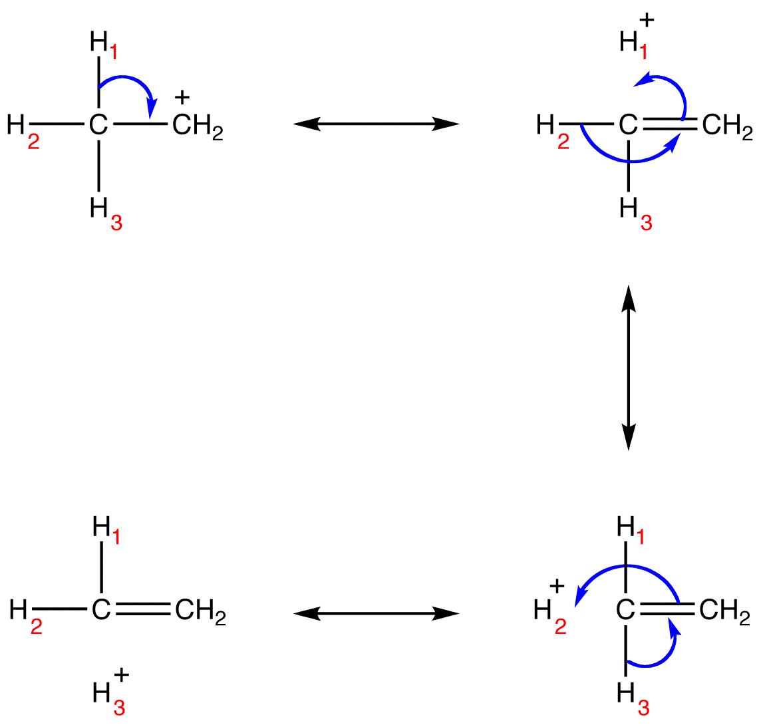
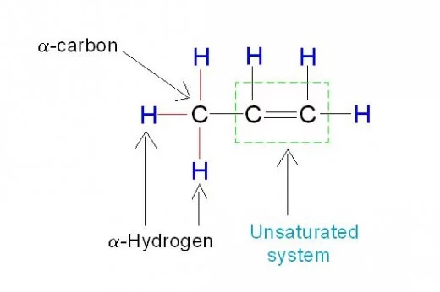
5. Hyperconjugation or no bond resonance
The electrons of the sigma bond between C and H are involved in
delocalisation
It depends on the number of α−hydrogens: More the number of α−hydrogens, more the number of hyperconjugative structures, more will be the stability of ion or molecule
Relative stability of 1-butene and 2-butene
Applications
Stability of carbocations

